Slide 1
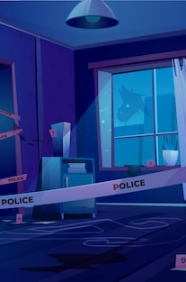

SQL Murder Mystery -Knightlab

Slide 2

What is SQL?
SQL, which stands for Structured Query Language, is a way to interact with relational databases and tables in a way that allows us humans to gather specific, meaningful information.
SQL is like the conductor of an orchestra, directing your database to retrieve, manipulate, and manage data efficiently. It's the language that speaks to databases, making them understand your commands, whether it's fetching specific information, updating records, or performing complex calculations.

Slide 3
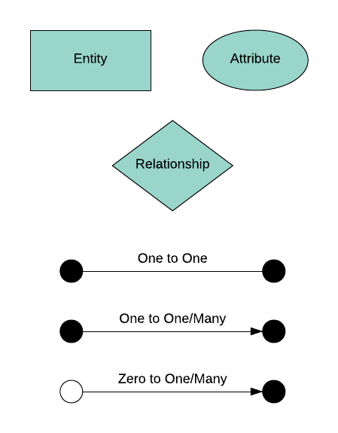
What is an ERD?
ERD, which stands for Entity Relationship Diagram, is a visual representation of the relationships among all relevant tables within a database.
Primary Key : a unique identifier for each row in a table.
Foreign Key : used to reference data in one table to those in another table.

Slide 4
Functional Keywords & Wildcards to Solve Murder Mystery Solution.
SELECT: Used to retrieve data from a database.
FROM: Specifies the table(s) from which to retrieve the data.
WHERE: Filters data based on specified criteria.
JOIN: Combines rows from two or more tables based on a related column between them.
GROUP BY: Groups rows sharing a property into summary rows.
HAVING: Filters the results of a GROUP BY clause.
ORDER BY: Sorts the result set in ascending or descending order.
DISTINCT: Returns unique values in a specified column or columns.
COUNT(): Returns the number of rows that match a specified criteria.
AS: Renames a column or table with an alias.
BETWEEN: Filters the result set within a range.
LIKE: Searches for a specified pattern in a column.
IN: Specifies multiple values for a WHERE clause.
% (percent): Represents zero or more characters.

Slide 5
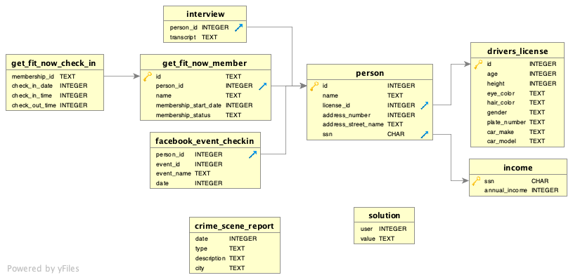
ERD for our SQL Murder Mystery is given above. The diagram shows that each table has a name (top of the box, in bold), a list of column names (on the left) and their corresponding data types (on the right, in all caps). There are also some gold key icons, blue arrow icons and gray arrows on the ERD. A gold key indicates that the column is the ​primary key​ of the corresponding table, and a blue arrow indicates that the column is the ​foreign key​ of the corresponding table.

Slide 6
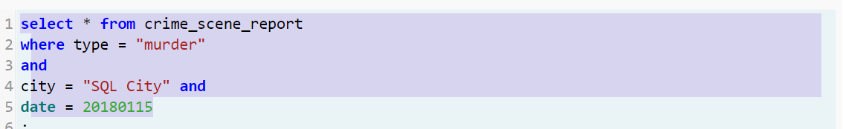
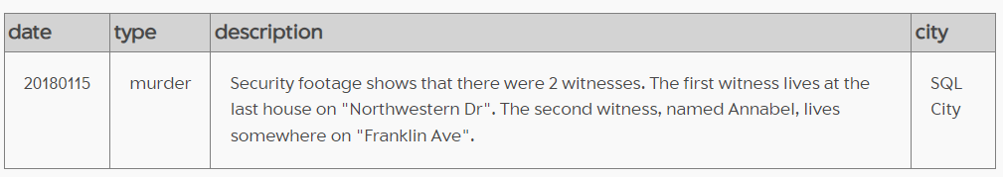
Investigating the Murder in SQL City on January 15, 2018
A crime has taken place and the detective needs your help. The detective gave you the crime scene report, but you somehow lost it. You vaguely remember that the crime was a ​murder​ that occurred sometime on ​Jan.15, 2018​ and that it took place in ​SQL City​. Start by retrieving the corresponding crime scene report from the police department’s database.

Slide 7
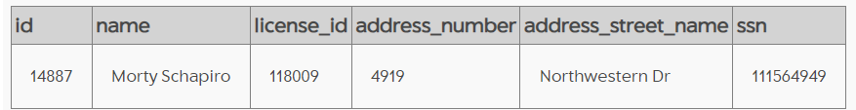
Locating Annabel on Franklin Ave and the Last Resident of Northwestern Dr
Locating Last resident of Northwestern Dr

Slide 8
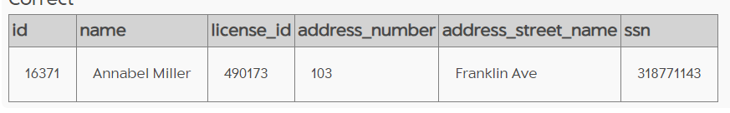
2. Locating Annabel on Franklin Ave

Slide 9
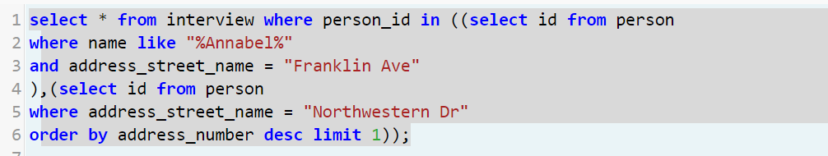
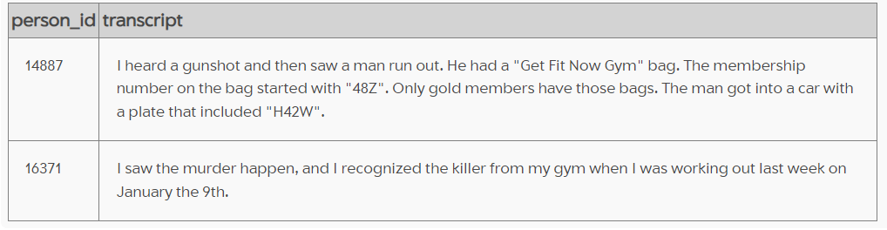
Interviews with Annabel from Franklin Ave and the Last Resident of Northwestern Dr

Slide 10
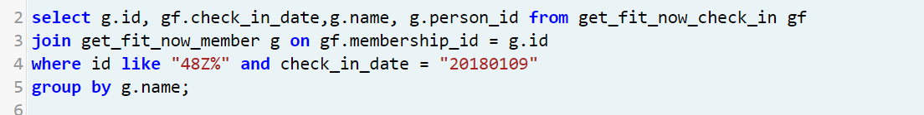
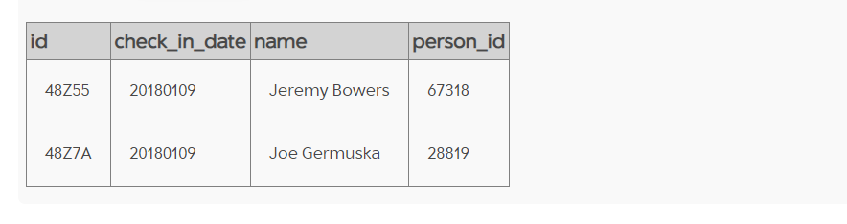
Get Fit Now Check-Ins on January 9, 2018, for Members with ID Starting with 48Z

Slide 11
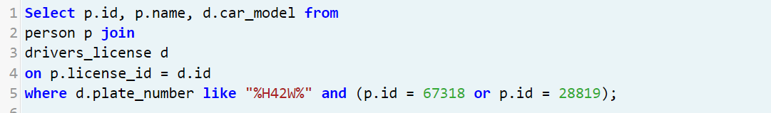
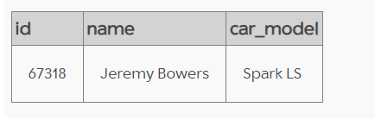
Matching Persons with Driver's License Information for Vehicles with Plate Number Like H42W

Slide 12

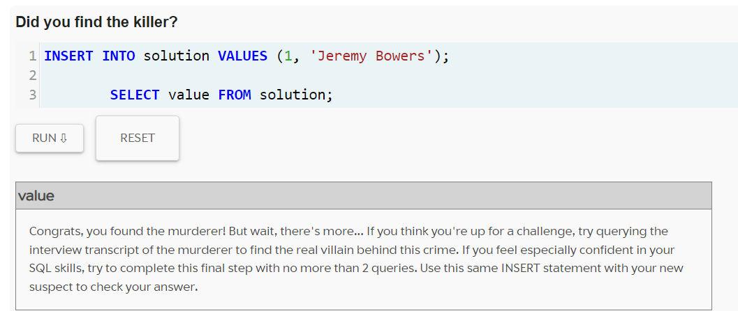
Unlocking the Mystery: Jeremy Bowers' Solution Revealed
Jeremy Bowers Under Scrutiny

Slide 13

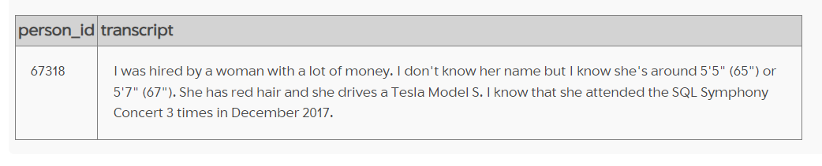
2. Killers Confession

Slide 14
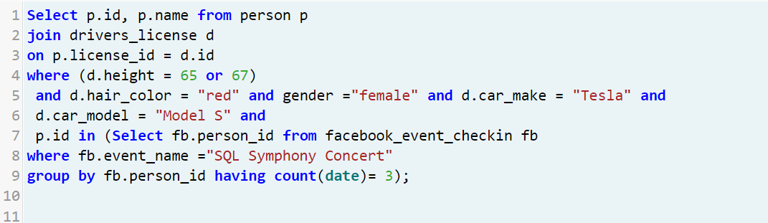
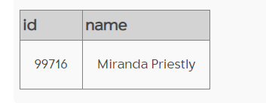
Unraveling the Mystery
Tracking the Tesla Driver at the SQL Symphony Concert

Slide 15
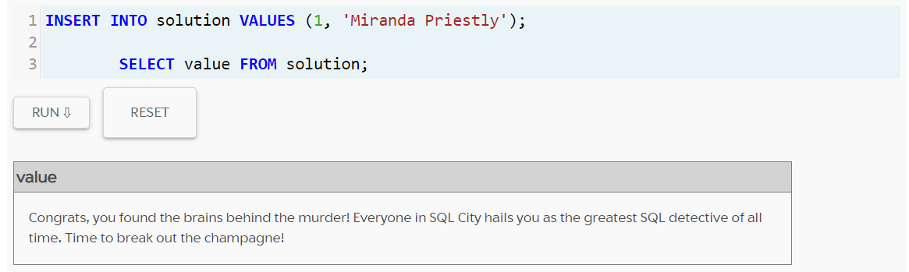
2. Miranda Priestly's Connection to the Crime

Slide 16
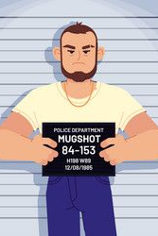
Justice Served: Closing the Case on the Murder Mystery
After lots of digging and detective work, I finally found out who did it. Jeremy Bowers was the one who committed the murder. And it turns out, Merinda Priestly was the person who hired him to do it. With this information, we've solved the case and brought the people responsible to justice. It's been a tough journey, but now I can give some closure to the families affected and bring peace back to our community.

Slide 17
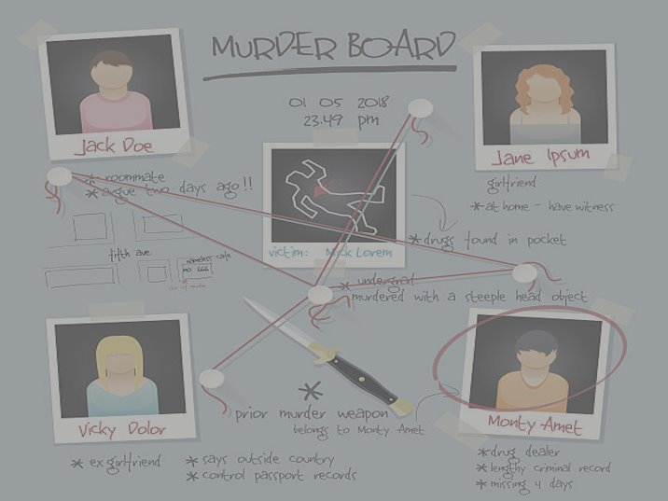
Thank you
Gambare Gambare!!!!!

